Slide 1
Multimodal Information Retrieval in Open-world Environment Right Information at the Right Time
KMA Solaiman
Purdue University
ksolaima@purdue.edu

Slide 2
Problem formulation
Build systems capable of satisfying multimodal information needs in open-world environments
Make sense of data from novel and heterogeneous sources
User satisfaction for multimodal information extraction in real-world depends on few pivotal aspects:
Consume and process streaming and at-rest heterogeneous data
On-demand data delivery
Handle lack of class labels
Resource constrained data preprocessing
Adapt to novel situations including changes in data and sources
Notes:
Real-world system needs to consume and process large number of streaming and at-rest heterogeneous data from multiple independent sources and modalities.
On-demand use-cases require online data delivery.
Most use cases in open-world lack the class labels
With the influx of new data, retrieval algorithms need to use the existing feature extraction models, which needs to adapt to the resource constraints.
Data retrieval systems need to assess the intrinsic complexity of the datasets and must be adaptable to novel changes in data (i.e., data shift and concept drift).

Slide 3
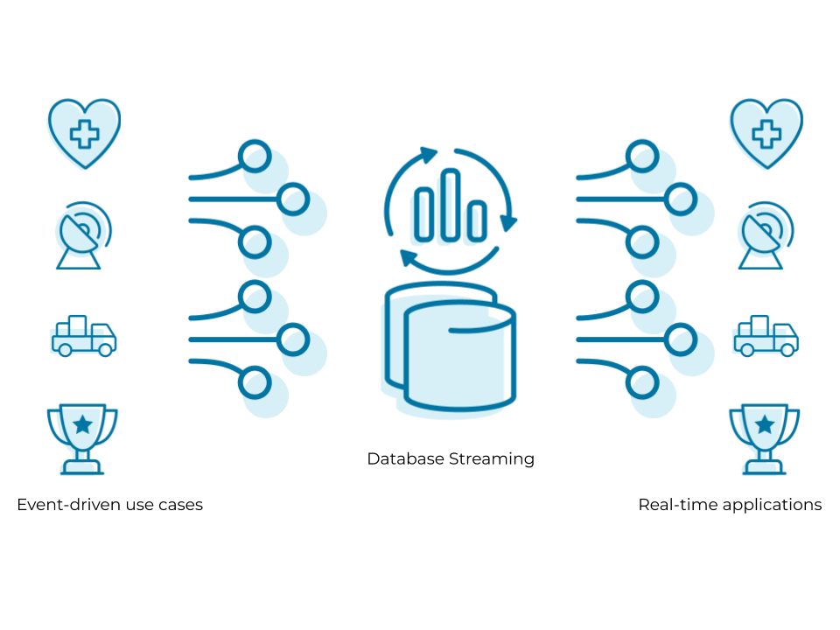
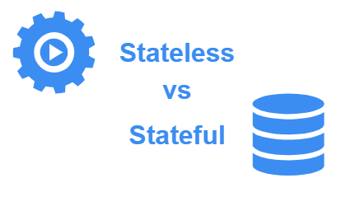




Challenge 1: Ingestion and Delivery
At Rest
Feature Extraction
And
Information Retrieval Models
Notes:
Real-time streaming and at-rest data consumption and On-time Data delivery
Stateful from stateless

Slide 4
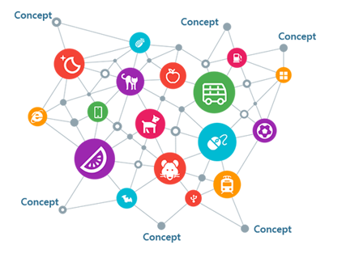
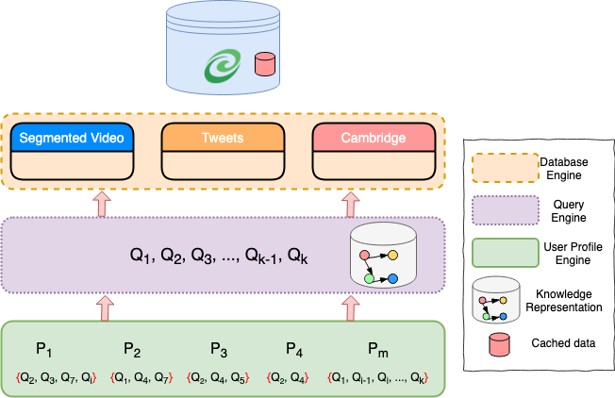



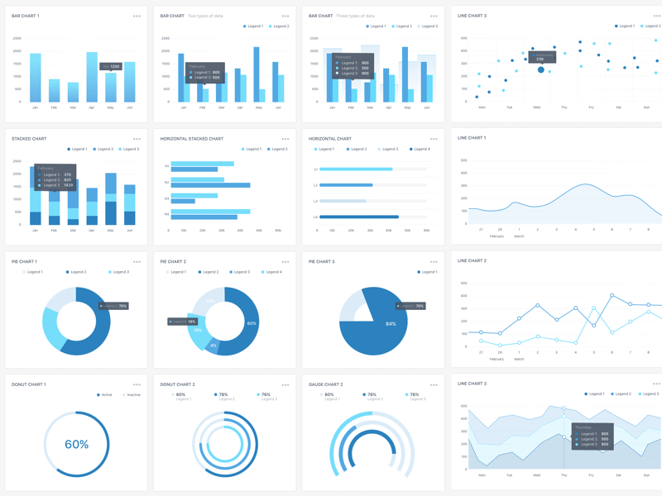

Situational Knowledge on Demand
Feature Extraction
ML, NLP
Index Constructor
Multimodal Streaming Data
Data Sources:
Video: Traffic Cam, Static Cam
Social Media: Twitter
Text: Cambridge / WL City Data
Data type Processors
NLP (Text)
Knowledge Base
2
Vision (Video)
3
Kafka Topics
1
PostgreSQL
Indexing Layer
Video
ES Writer/Mapper
Text
4
5
Front End
Microservice
User Profiling
Users’ queries
Triggers
Heterogeneous Data Streams
Active Learning
Knowledge derived from queries
Situation-aware Recommendation
Situational Aware Indexed Data
Relevant patterns of data
Notes:
SKOD
SurvQ

Slide 5









Challenge 2: Resource constrained Data-preprocessing
Notes:
Need training data
Or large GPU
No manpower
System needs to update and deliver

Slide 6



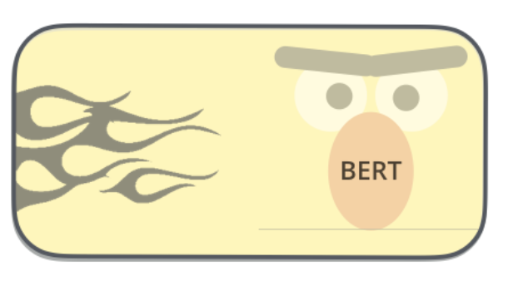




Resource Constrained Feature Extraction
Text Feature Extraction
Regular Expression
Word Embedding
Language Models
PoS-based Classifiers
Video and Image Feature Extraction
Priority System
Object Detection
Notes:
HART
SurvQ
Priority system enables real-time analysis
Database communication can scale

Slide 7
Feature Extraction from Incident Report
Parsing Incident Report for automatic extraction of Features
Beneficial for creating Postgres Triggers to identify similarity of incoming incidents to previous queries
Approach 1: Build Regular expressions to filter out features and feature values. Assumptions -
Reports are highly regular
Report follows grammar and is correctly structured

Slide 8
Feature Extraction from Incident Report
Approach 2: Build separate classifiers for each features separately and build an ensemble of classifiers
Find related sentences that mentions selected features
Classifiers based on each features separately
Latent Semantic Analysis (LSI)
SVM, DTL
Improve upon basic BoW features with
Embeddings
PoS, Feature Names
BERT[2], Glove[1]

Slide 9



Query results over time
User Query
Notification for Newly Streamed Relevant Data
Incomplete Results
From single modality
Trigger Functions
Notes:
Trigger functionalities from [1]

Slide 10
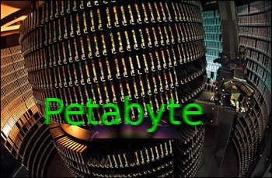



Challenge 3: Label Independent Data Integration
Notes:
Speed and scale
Novel data sources and approximate matching

Slide 11








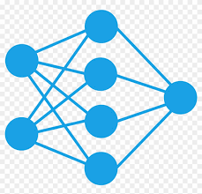

Knowledge Discovery
①
Capture Streaming Data;
Pre-processing; Convert to MP4, txt; Store in Postgres
(Data Capture and Data Storage)
②
Run ML and heuristic models on
video, text and tweets
(Feature Identification)
③
Create Query from User Requirement with DDL and return JOIN results
(Data Fusion)
④
Return relevant results to user’s examples
(Data Retrieval)
Notes:
Data Ingestion supports scalability and real-time analysis
Different feature identification techniques for different contexts
Fusion with RDBMS and relational queries allows scalability and automated investigation with Situational Awareness
Complete query results over time
Easy-to-use Interface for everyone
Data Models and Information Association
Constructing entity-attribute-relationship (EAR) model of the application domain
mapping this to a relational data base with schema S
streaming data is captured and loaded into the database
new data sources require extending the EAR and the schema.
User Queries
Either standing queries or one-shot queries
One shot queries are translated into SQL for S and executed immediately
Other Similarity Comparisons are approximate queries, and can be made with appropriate predicates
Rest is feature extraction to be done at load time

Slide 12
Relevance Modeling and Data Fusion
12
Notes:
Single information model for data representation
Can scale to any number of modalities
Plug-and-play with other data sources

Slide 13

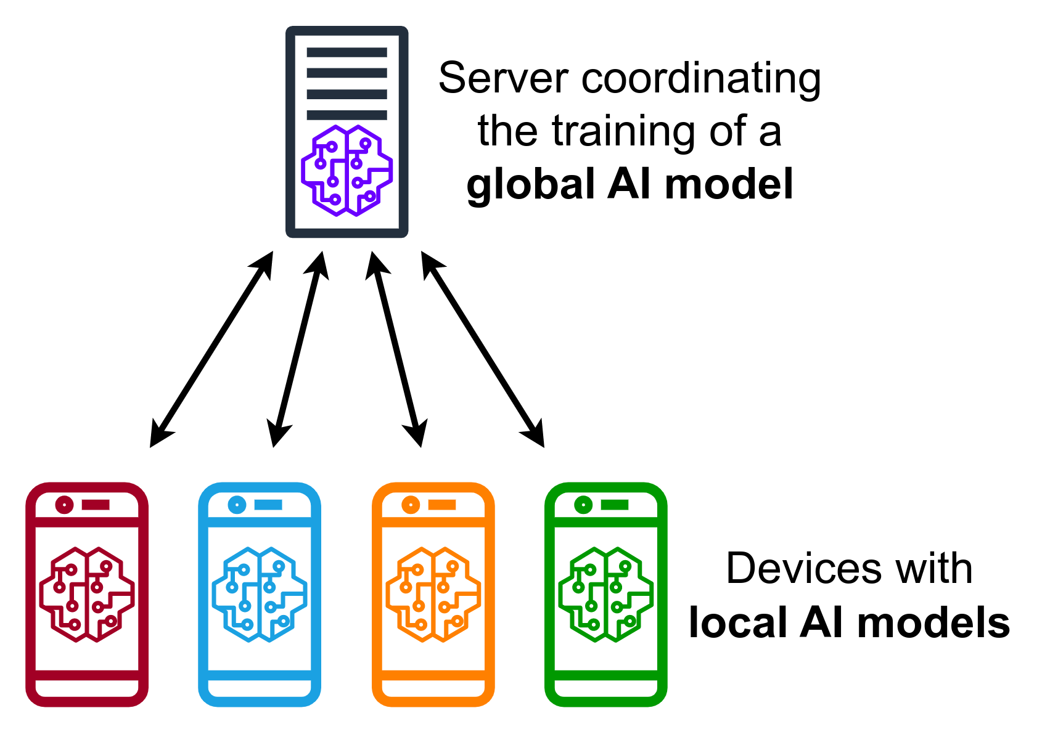

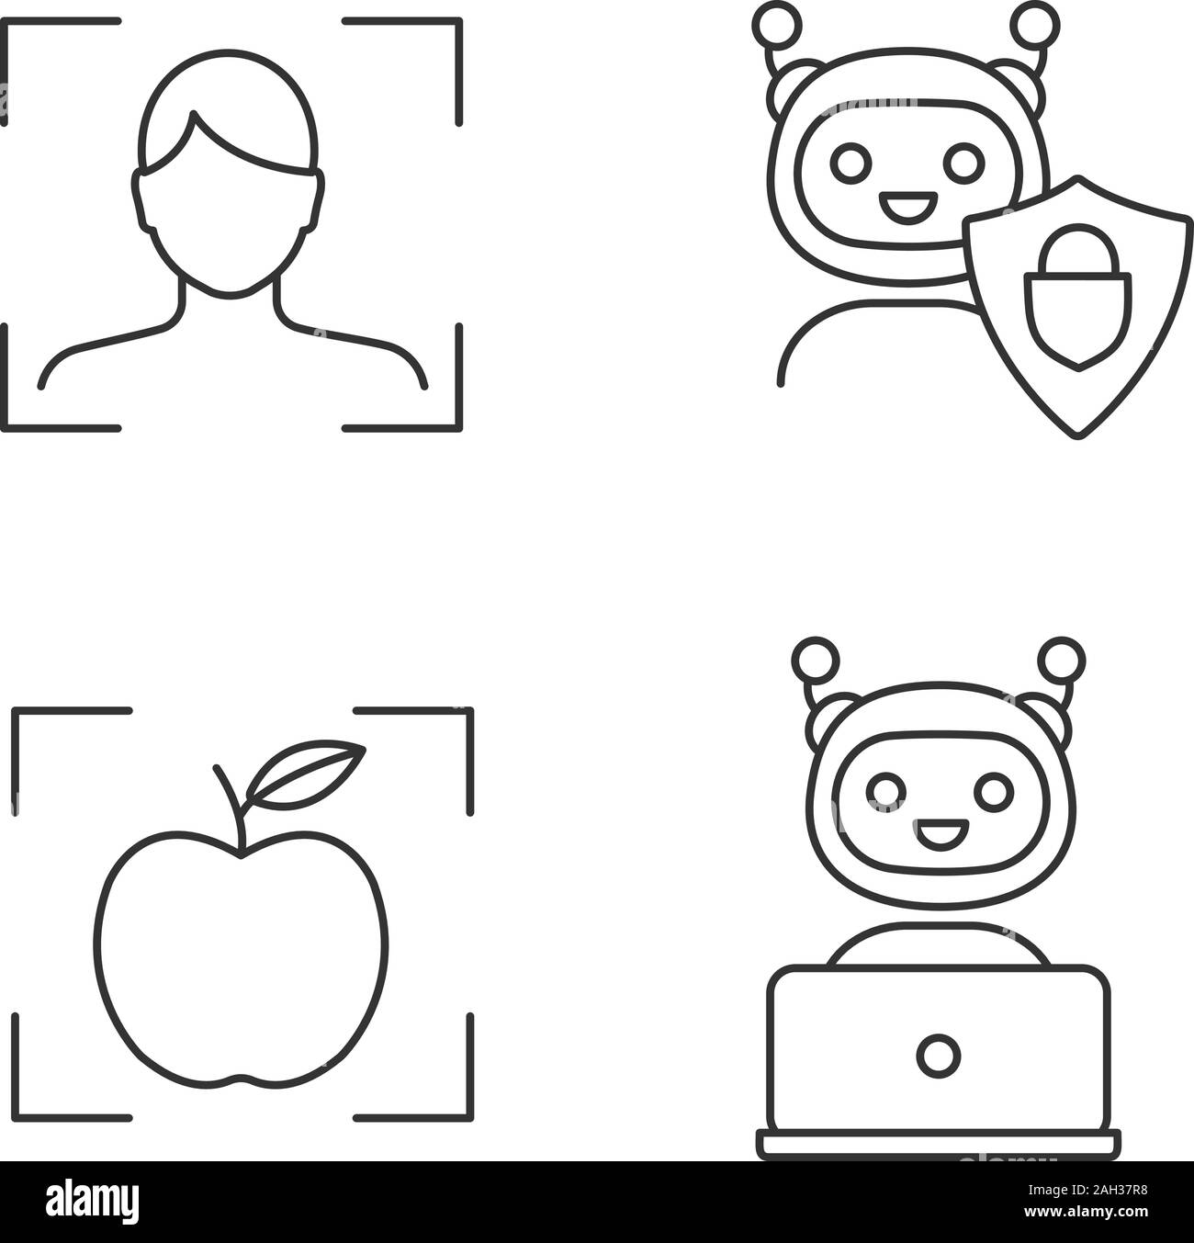
Challenge 4: Adaption to Open-world Novelties
Notes:
Dataset Complexity

Slide 14
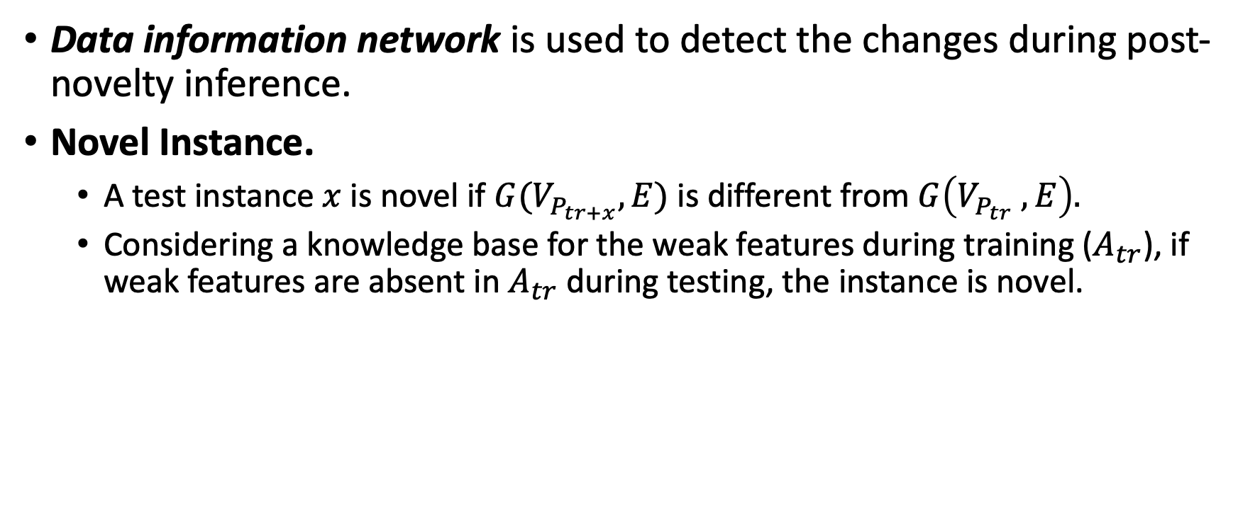
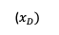
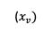
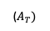
Novelty detection
Data information network is used to detect the changes during post-novelty inference.
Novel Instance.
A test instance $x$ is novel if $G(V_{P_{tr+x}}, E)$ is different from $G\left(V_{P_{tr}} , E\right).$
Considering a knowledge base for the weak features during training ($A_{tr}$), if weak features are absent in $A_{tr}$ during testing, the instance is novel.
($x_{D})$
($x_{v})$
($A_{T})$
Notes:
In the later case, we may see a decline in the model performance.
Post novelty graph is created after translation and weak feature extraction
For novel modality, framework either identifies the new weak features (different from training time) or tackles the new modality as part of the training distribution.

Slide 15
Weakly Supervised Learning
translation from different modalities of data to a textual representation
weak feature labels extraction
creation of data information network by connecting data samples to their features via their interactions
construct a structure-infused textual representation, by jointly embedding in a single space
the data samples,
the features in which these data samples are similar,
the similarity labels associated

Slide 16

EXAMPLE APPLICATION DOMAIN: POLICE INVESTIGATION SYSTEM Similar System in Practice
https://www.fbi.gov/services/cjis/ndex
Unclassified national information sharing system that enables criminal justice agencies to search, link, analyze, and share local, state, tribal, and federal records.
Strategic investigative information sharing system that fills informational gaps and provides situational awareness.
Analysts: Connecting the Dots
Detectives: Linking Investigations
Patrol Officers: Preparing for Encounters
Regional Dispatchers: Increasing Officer Safety
incident, arrest, and booking reports; pretrial investigations; supervised released reports; calls for service; photos; and field contact/identification records.

Slide 17
Future Research Directions

Slide 18
Future Research
% \item User requirement is not always obvious or explicitly stated. Learning algorithms need to adapt to changing user preferrence and delivered data must be relevant to user requirement. %%%%%
% \item Without proper context and explanation the delivered data is not useful to user. %%%%%
% % Explanability
%%%%%% Federated Learning / Data virtualization/data federation
%%%%%% Data Democratization
% Missing piece of information in one modality can be filled in with similar information from another modality.
% fill in missing data one modality with another

Slide 19
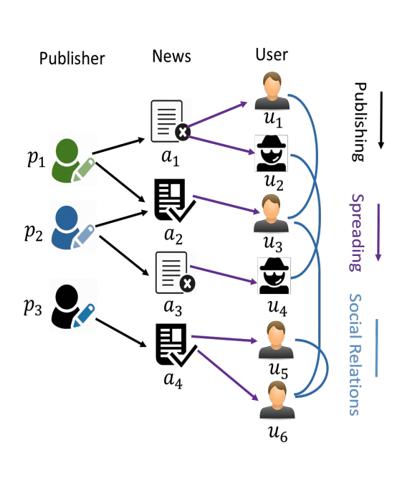
Interactive reasoning to cross check integrity and credibility of multimodal data
Detecting fake police leads/ tweets/ [report/ tip news articles] and explaining why it is detected as fake
Provide insights and knowledge to domain experts
Explainable features from noisy auxiliary information can further help detection performance
Social context provides rich auxiliary information beyond news content [Tweets and Reports]
Goal: learn representations from the heterogeneous network
Jointly embedding reports/ news articles and social context
Information from different modality can help to explain and detect authenticity of another [WeTip News and Tweets]
How to model content-content relations?
How to leverage authentic knowledge base structured information?

Slide 20
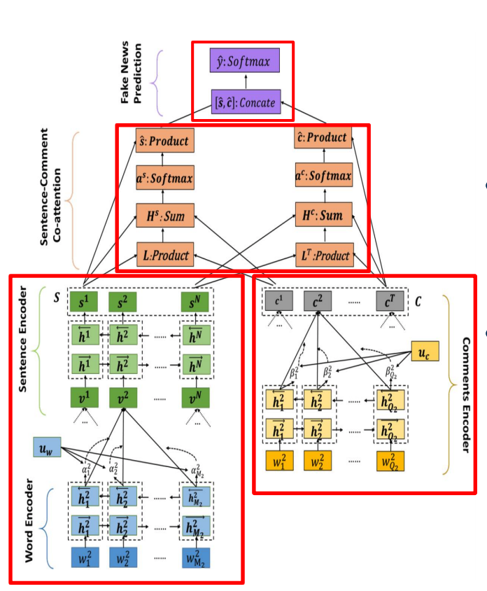
Detection of information credibility with explanation
Learn representations for each modality of data
Different Attention Networks depending on the data type
Select top explainable sentences and tweets through a co-attention network
Detect fake leads with concatenated sentence and tweet representations as Classification task
dEFEND
Kai Shu, Limeng Cui, Suhang Wang, Dongwon Lee, and Huan Liu. ``dEFEND: Explainable Fake News Detection", KDD 2019, August 4-8, 2019. Anchorage, Alaska.

Slide 21
Multiple Data of Interest to Different Users
Academia
U₁
U₂
U₃
Extract human-interpretable topics from a document corpus
Each topic characterized by words most strongly associated with
Documents as mixtures of topics that spit out words with certain probabilities.
No need to re-train
T_{c}
T_{A}
T_{B}
Disaster
Academia
Crime
Streaming
Data
D₁₆
D₁₆
D₀ | D₁ | D₂ | D₃
D₄ | D₅ | D₆ | D₇
D₈ | D₉ | D₁₀ | D₁₁
D₁₂ | D₁₃ | D₁₄ | D₁₅
D₃₁
Data at Rest
D₃₁
Notes:
Topic A: 30% broccoli, 15% bananas, 10% breakfast, 10% munching, … (at which point, you could interpret topic A to be about food)
Topic B: 20% chinchillas, 20% kittens, 20% cute, 15% hamster, … (at which point, you could interpret topic B to be about cute animals)
LDA assumes the following generative process for each document w in a corpus D:
Choose N ∼ Poisson(ξ).
Choose θ ∼ Dir(α).
For each of the N words w_{n}: (a) Choose a topic z_{n} ∼ Multinomial(θ). (b) Choose a word w_{n} from p(w_{n} | z_{n} ,β), a multinomial probability conditioned on the topic z_{n}.

Slide 22
User Modeling: Intention-aware Recommendation Engine
Sends users streaming data that corresponds to their interests
Builds User Profiles using the history of user queries
Active Learning to narrow/expand intention model with more interaction
Expands user queries with word embedding models to fetch relevant data from the database
Analyze user queries for user profiling
Expand result of queries with word2vec
Active Learning to improve intention model with time
User1
Cars of specific make & model (purple Cadillac)
Interested in info. about crimes in a specific district
SELECT * FROM video_data WHERE object = ‘car’ and attribute=‘purple’
User2
SELECT * FROM crash_data WHERE
date_hit = TODAY
Looks for pedestrians in the video data
Interested in traffic, accidents, violations

Slide 23









Future Works
Additional Features
Integrate Other Data Sources
Expand the current data modalities
User Modeling
Feature Extraction as part of relevance modeling

Slide 24
Funding

Slide 25
Grants and Proposals
vector DBMS proposal for NSF-planning
DARPA ITM
to support building, evaluating, and fielding algorithmic decision-makers that can assume human-off-the-loop decision-making responsibilities in difficult domains, such as medical triage in combat.
Difficult domains are those where trusted decision-makers disagree; no right answer exists; and uncertainty, time-pressure, resource limitations, and conflicting values create significant decision-making challenges.
Other examples of difficult domains include first response and disaster relief.
DARPA Triage
NSF Safe Learning-Enabled Systems
Ensuring system safety requires more than improving accuracy, efficiency, and scalability: it requires ensuring that systems are robust to extreme events, and monitoring them for anomalous and unsafe behavior.
Sandia project

Slide 26
Potential Collaborations
Existing interdisciplinary research centers and initiatives
Institute for Defense Analyses (IDA), Information Sciences Institute (ISI) → Novelties in Planning domain
MIT (Mike Stonebraker) and University of Michigan (Mike Cafarella) → Situational Knowledge on Demand
Collaboration | Area | Collaborators
Explanability and Trust | Multimodal information retrieval | Prof. Yongjian Fu
Resource Management, Information Completeness | Disaster Resilience | Prof. Satish Kumar
Weak supervision, Credibility, User Modeling | Social media analysis and Big Data | Prof. Sun Chung
Scalability and Unsupervised, information credibility with explanation | Situational Awareness | Prof. A Essa

Slide 27
Drs. J. Woldering, S. Mal-Sarkar, Z. Chi, A. Essa
What is offered in graduate seminar, systems programming
Data Comm. & Networking (what is current situation), What is difference between ug and grad c/C++, Research: uncertainty management, CIS Curriculum Committee: Helps develop CIS course curriculum ➔ How
Also, data comm & networking, work in IOT, He wang work relate
AI, graphics, software eng, Multimedia?? ; *** computer vision and machine learning for object detection, tracking and identification, wide area surveillance and scene analysis for security automation and situational awareness, face detection and recognition, facial expression analysis, and remote sensing, illumiation invariant face recog

Slide 28
Heavy weight research profs
Drs. S. Kumar, T. Zhang, Y. Zhu, J. Zhan
Disaster Resilience, Health Informatics, Big Data (mainly phd research); how special topics are taught
Teaches AI; adversarial robustness on artificial intelligence systems, optimization
current research focuses on network security and privacy, computer networking and distributed systems, and pervasive computing (can talk about federated learning paper)
Automata, digital image processing, grad intro to algorithms; Multiple Pedestrian Tracking by Combining Particle Filter and Network Flow Model, traffic data collection for multi-type vehicle

Slide 29
Drs. H.Wang, Q. Lin, S. Poudyal, S. Chung, J. San
wireless and mobile computing, security/privacy in pervasive computing, information retrieval and efficient data management in wireless networked embedded systems Efficient information management in distributed embedded systems. Snoogle - the first search engine prototype for the physical world that allows people to search for the interested objects in their vicinity. Snoogle effectively bridges Internet and the isolated objects in the physical world.
Motion Planning, Control, Autonomous Systems, Robotics, Machine Learning, Verification
What do you do in Educational Data Mining, Artificial Intelligence, Image Processing
* Big Data Analytics, AI and Cyber Security Lab (image QA, social media mining), colab with IBM health (teaches databases and data mining)
Rego’s student; OS/ compilers/ parallel algo

Slide 30
TEACHING GRANTS / PROPOSALS (LAST 4 YEARS ONLY) University Tech Support Award for Big Data Teaching Lab in Computer Science: Awarded in the amount of $12,648, April 2018
Built Big Data Analytics Research Lab (FH305) in EECS Dept, College of Engineering, Sept 2018
Grant Proposal on Cross-Disciplinary Course Development for Big Data Analytics Systems in Cloud based IoT”, Sunnie Chung (CSU), Pan Li, (Case Western Reserve University) to Cleveland Foundation, July 2017

Slide 31
THANK YOU
Questions?

Slide 32
Weakly Supervised labels
Representing data in terms of different structural features through which different modalities of data can be similar
Structural representation of raw unstructured texts (with topics, entities, events, and relationships) allows readers to infer better knowledge
Feature labels are generated automatically in two steps –
a textual description of each data sample is generated from any modality;
topics, entities, and events are extracted from the textual descriptions and are considered as weak labels for two reasons.
quality of the extracted structural units rely on the choice of the extraction models and can be noisy.
output generated from the modality specific textual descriptors can be ambiguous and noisy.

Slide 33
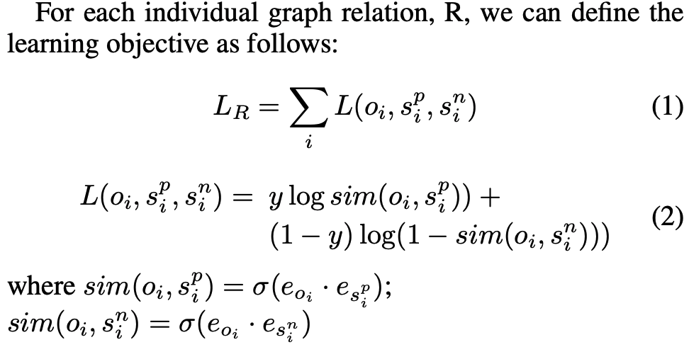
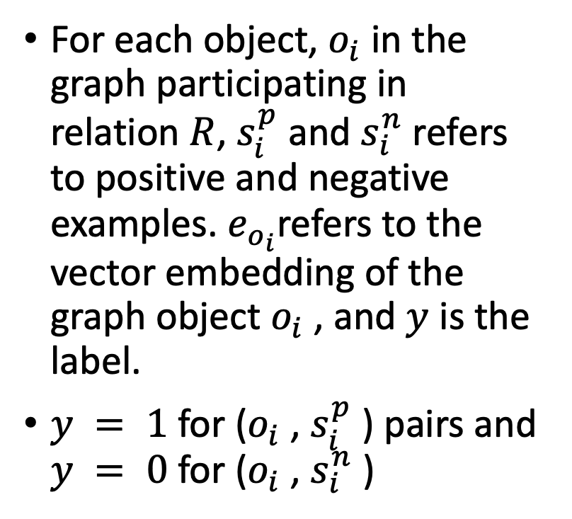
Multi-task learning
For each object, $o_{i}$in the graph participating in relation $R$, $s_{i}^{p}$ and $s_{i}^{n}$refers to positive and negative examples. $e_{o_{i}}$refers to the vector embedding of the graph object $o_{i}$ , and $y$ is the label.
$y = 1$for ($o_{i}$ , $s_{i}^{p}$ ) pairs and $y = 0$for ($o_{i}$ , $s_{i}^{n}$ )
Notes:
. In the embedding space, the relations originally defined over the vertices in the information graph are expressed as a similarity score between the vectors representing these vertices. The relationships between the features themselves are also expressed as a similarity score between the vectors representing them. To force these relationship constraints on the data samples, we consider this as a multi-task learning problem, over all the relations in the graph.
For example, if a document and a video, or two documents have same topic, they should have similar embedding. In parallel, if the two data samples are discussing about the same event, they should have similar embedding. Our embedding function should jointly reflect these similarities
The objective of the model is to maximize the similarity with a positive example and minimize the similarity with a negative example.

Slide 34
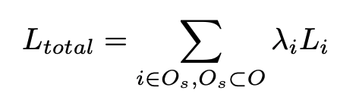
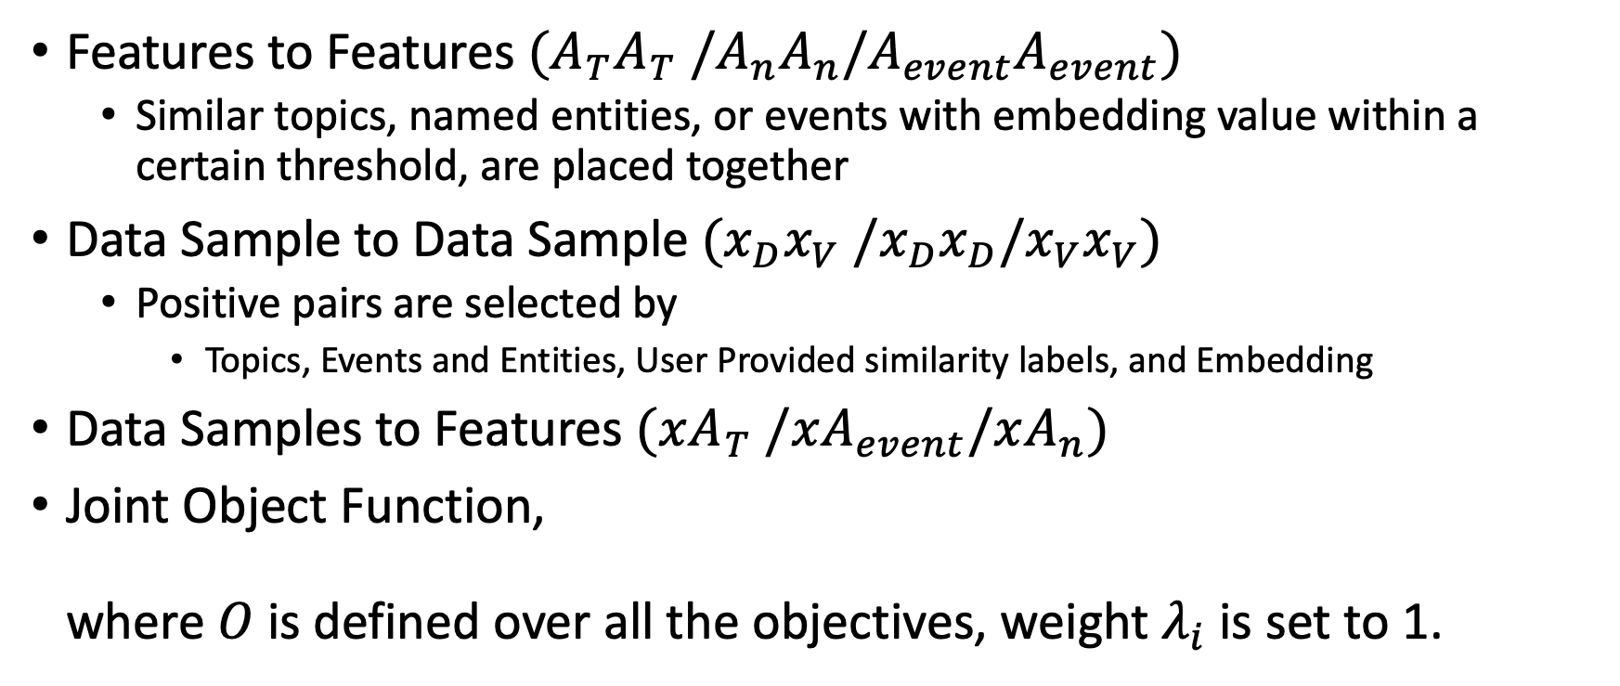
Learning objectives
Features to Features $(A_{T}A_{T} /A_{n}A_{n}/A_{event}A_{event})$
Similar topics, named entities, or events with embedding value within a certain threshold, are placed together
Data Sample to Data Sample $(x_{D}x_{V} /x_{D}x_{D}/x_{V}x_{V})$
Positive pairs are selected by
Topics, Events and Entities, User Provided similarity labels, and Embedding
Data Samples to Features $(xA_{T} /xA_{event}/xA_{n})$
Joint Object Function, where $O$ is defined over all the objectives, weight $λ_{i}$ is set to 1.

Slide 35
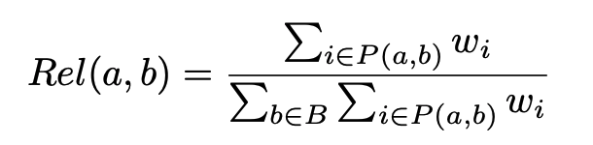
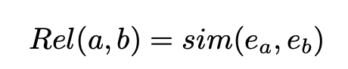
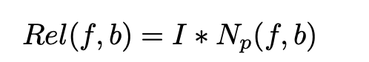
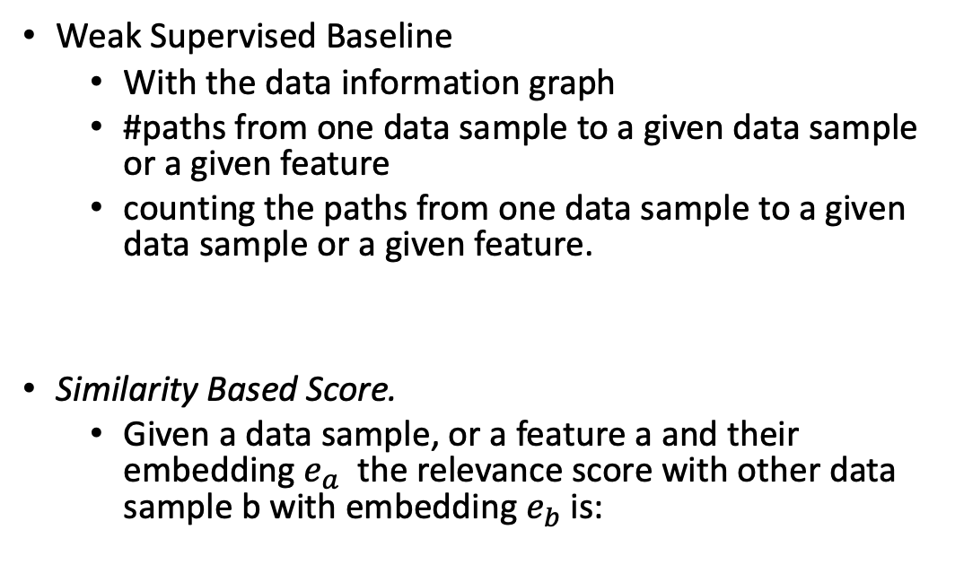
Reasoning Over the Data Information Network
Weak Supervised Baseline
With the data information graph
#paths from one data sample to a given data sample or a given feature
counting the paths from one data sample to a given data sample or a given feature.
Similarity Based Score.
Given a data sample, or a feature a and their embedding $e_{a}$ the relevance score with other data sample b with embedding $e_{b}$ is:

Slide 36
Novelty Characterization
Covariate shift with change in application domain with the modalities for which translation module is available (covar-1).
Prior probability shift with novel weak features (prior-1).
Prior probability shift with no weak features (prior-2).
Prior probability shift with novel relevance label (prior-3).
Temporal concept drift with previously relevant data being non-relevant (concept-1).
Covariate shift with new modality introduction (covar-2).

Slide 37
Novelty response
pre-trained retrieval model from WeS-Jem
three level training strategy
With new modality introduction novelty, both image and LIDAR modality can be handled with the video translation module. Initial text embedding approaches can generate text embedding for any textual input for prior data shift.
Linear embedding layers in WeS-JEm maps the OOD inputs into the pre-trained joint embedding space
For (prior-2) novelty, when system relearns, only the (xx-embedding) objective functions remains active
For novel modality introduction, a new translation method can be learned.
User similarity labels provided by Relevance Feedback module have greater weights than old ones
Notes:
The final similarity score between data samples in the embedding space would produce the relevance between new samples.

